Slide 1
CLAY POT IRRIGATION
Presented by
Mike and Paulette Flynn
May 10, 2014

Slide 2
A Centuries Old Method
Saves water & time
Uses the natural force of transpiration and wicking to water plants at the root zone
Always supplies the right amount of water needed by your plant
Water is at the root zone where it is needed
PERFECT FOR THE LAZY GARDENER!

Slide 3
Works Best for Annuals
Clay pot irrigation is effective on annual flowers and veggies
Especially good for tomatoes!
Do not use on root crops like carrots, potatoes, beets, because the root will grow toward the pot
Do not use on trees and other perennials, as the pot is not deep enough to be effective & removing the pot at season end may upset the roots

Slide 4
Preparing & Sealing the Clay Pot
Use unglazed clay garden pots
Seal bottom hole with silicone adhesive on both inside and outside of pot
Allow to dry completely
Once the adhesive is completely dry, fill with water and let set 24 hours to test for leaks
If leaking, re-apply silicone and re-test when dry

Slide 5
Sealing the Pot-Step 1
Cover the bottom hole with Scotch Tape from the inside of the pot
Turn pot over and fill hole with silicone adhesive
Spread it beyond the circumference of the hole
Allow pot to dry for 24 hours; remove tape

Slide 6
Sealing the Pot-Step 2
Apply silicone adhesive to cover hole from inside of pot and spread beyond circumference of the hole
Let dry 24 hours
Fill with water and test for leaks
If leaking, add more silicone and let dry
Re-test for leaks

Slide 7
Ground Preparation in Garden
Clay Pot Irrigation works best with lighter soils—add compost and/or vermiculite to heavy clay
Loosen the soil and then “plant” the pots at the same time you plant your seedlings

Slide 8
Placing the Clay Pot in the Ground
It is important that the pot is buried flush with the level of the garden soil
Make sure that the soil is touching the pot all the way around—use your best soil close to the pot

Slide 9
Arranging the Plants Around the Pot
Each pot can water 4 plants
Place the plants approximately 8 inches from the pot—not more than 12 inches
Lay out the bed in a checkerboard pattern

Slide 10
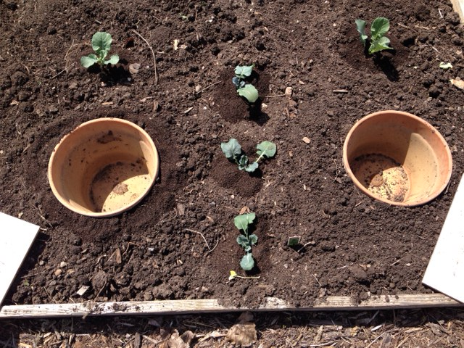

Slide 11
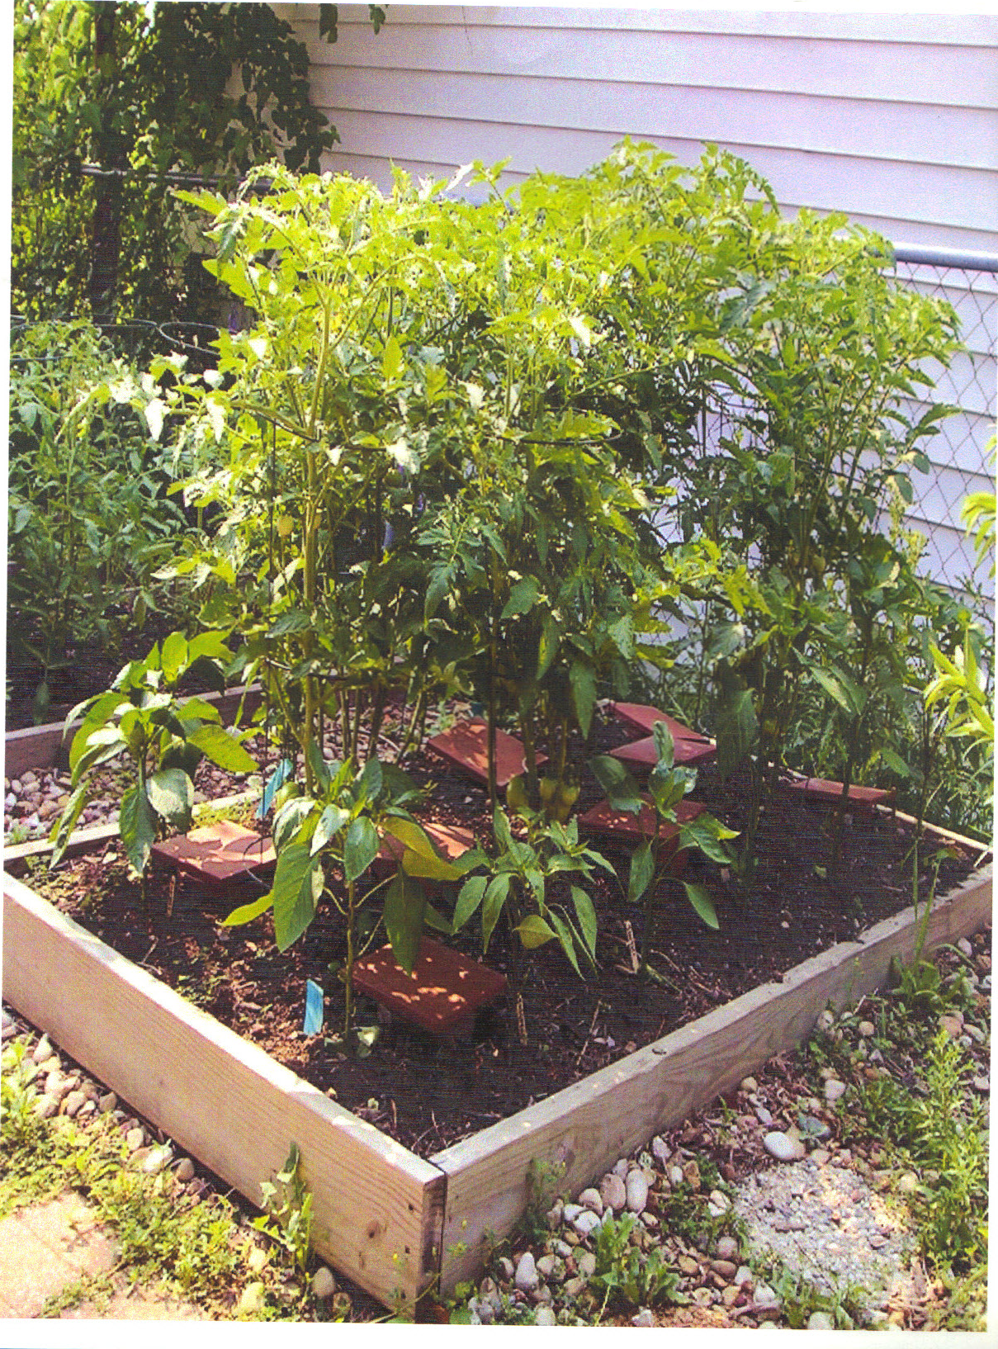

Slide 12
Filling the Clay Pot for the First Time
Fill the pot to the top with water
Let it spill over the top to completely wet the area close to the pot
Water the ground around the pot
Check in 24 hours to see if the pot is still holding water

Slide 13
Covering the Clay Pot
Cover the pot completely with a ceramic tile to lessen evaporation and control mosquitos
An 8 inch tile works for a 6 inch pot; 12 inch tile for a 10 inch pot, etc.
We found low cost tiles at the Habitat for Humanity Re-Store

Slide 14
Weekly Filling of Clay Pot
Check pots weekly and refill as needed.
Mature plants will use more water, so check large plants more often and/or in hot dry weather
As tempting as it may be, do not add fertilizer to the pot. This could close the pores of the pot.

Slide 15
End of Season Maintenance & Storage
Remove pots from garden at the end of season before hard frost
Wash with a solution of vinegar and water to remove any mineral build up
Store in a dry place for re-use next season
Before re-use, check that seals are still water tight and apply more adhesive, if needed.

Slide 16
HAPPY GARDENING from Your Friends at GreenQuest!
Mike Flynn
mikethewormguy@aol.com
Paulette Flynn
pauletteflynn3@gmail.com

